Slide 1


SUPERSTORE SALES DATABASE ANALYSIS
Comprehensive Business Intelligence Using Advanced SQL
BSc Data Science
rushisultane00@gmail.com
Presented by Rushikesh Narayan Sultane

Slide 2
AGENDA
Presentation Structure &
Query Overview
Introduction to Database & Project Scope
Customer Analysis (Queries 1–5)
Shipping & Order Analysis (Queries 6–11)
Product Performance & Sales Deep Dive (Queries 12–20)
Advanced Analytics with Window Functions (Queries 21–25) & Summary

Slide 3
CUSTOMER
ANALYSIS
Section 1: Queries 1–5
Understanding customer behavior, profitability, and segmentation.
Explore who your top customers are, which customers
span all regions, and where losses are concentrated.

Slide 4
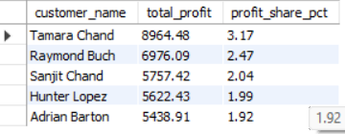
SELECT c.customer_name
SUM(s.profit) AS total_profit,
ROUND(SUM(s.profit) * 100 / (SELECT SUM(profit) FROM sales), 2) AS profit_share_pct
FROM sales s
INNER JOIN orders o ON s.order_id = o.order_id
INNER JOIN customers c ON o.customer_id = c.customer_id
GROUP BY c.customer_name
ORDER BY total_profit DESC
LIMIT 5;
QUERY 1: TOP 5
CUSTOMERS BY PROFIT
Objective: Identify Top 5 Profit-Contributing Customers
SQL Techniques: JOINs, GROUP BY, SUM(profit), percentage calculation.
Insight: The top 5 customers generate a disproportionately large share of total profit — highlighting key business contributors that deserve priority attention and retention strategies.
Query: SELECT customer_name, SUM(profit) AS total_profit FROM orders GROUP BY customer_name ORDER BY total_profit DESC LIMIT 5;

Slide 5
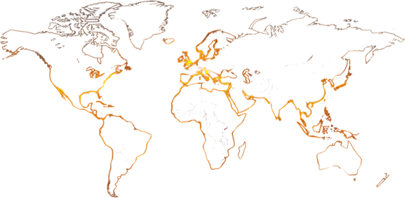
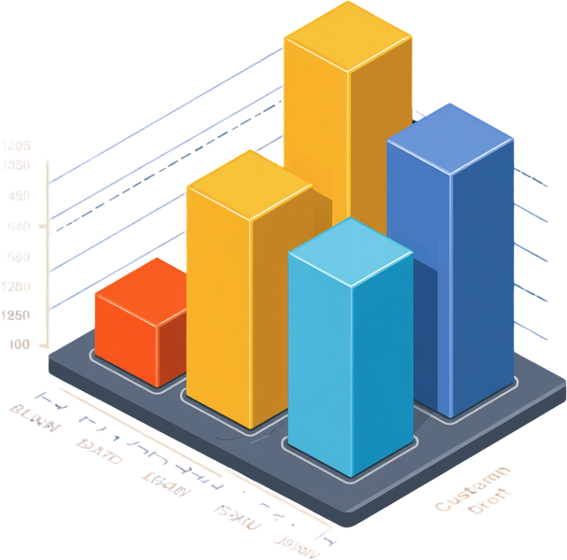
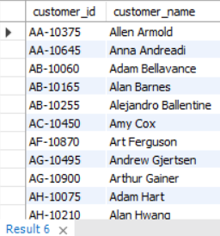

SELECT c.customer_id, c.customer_name
FROM customers c
INNER JOIN orders o ON c.customer_id = o.customer_id
GROUP BY c.customer_id, c.customer_name
HAVING COUNT(DISTINCT o.region) = 4;
QUERY 2: ALL-REGION
CUSTOMERS
Customers Ordering From All 4 Regions
Technique: JOIN, GROUP BY, HAVING COUNT(DISTINCT region) = 4. Objective: Find customers who placed orders in all four geographic regions. Insight: These customers show widespread engagement and loyalty, making them high-value targets for retention and cross-regional promotions.

Slide 6
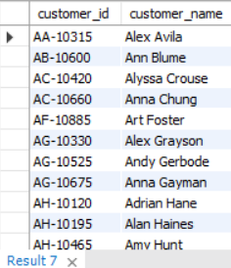
SELECT c.customer_id , c.customer_name
FROM customers c
INNER JOIN orders o ON c.customer_id = o.customer_id
INNER JOIN sales s ON o.order_id = s.order_id
GROUP BY c.customer_id , c.customer_name
HAVING SUM(s.profit) < 0;
QUERY 3: CUSTOMERS
WITH NEGATIVE PROFIT
Objective & SQL Technique
Identify customers generating negative total profit across all orders using JOIN, aggregation, and HAVING SUM(profit) < 0. Insight: Pinpoints loss-generating customers, enabling targeted retention, pricing adjustments, or cost reduction strategies to improve overall profitability.

Slide 7
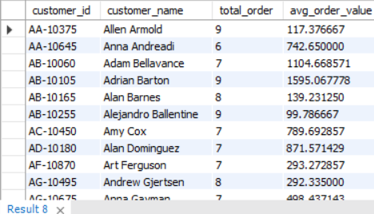
SELECT c.customer_id,c.customer_name ,
COUNT(DISTINCT o.order_id ) AS total_order,
SUM(s.sales) / COUNT(DISTINCT o.order_id) AS avg_order_value
FROM customers c
INNER JOIN orders o ON c.customer_id = o.customer_id
INNER JOIN sales s ON o.order_id = s.order_id
GROUP BY c.customer_id,c.customer_name
HAVING COUNT(DISTINCT o.order_id) > 5;
QUERY 4: CUSTOMERS
WITH >5 ORDERS & AOV
High-Frequency Customers & Average Order Value
Objective: Find customers with more than 5 orders and calculate their Average Order Value (AOV). Technique: JOINs, COUNT(DISTINCT order_id), SUM(sales) / COUNT(DISTINCT order_id). Insight: High-frequency customers with high AOV represent the most valuable segments — ideal targets for loyalty programs and premium upsell strategies.

Slide 8
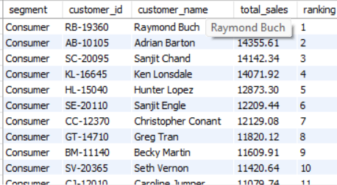
SELECT c.segment, c.customer_id,c.customer_name,
SUM(s.sales) AS total_sales,
RANK() OVER(PARTITION BY c.segment ORDER BY SUM(s.sales) DESC) AS ranking
FROM customers c
INNER JOIN orders o ON c.customer_id = o.customer_id
INNER JOIN sales s ON o.order_id = s.order_id
GROUP BY c.segment,c.customer_id,c.customer_name
ORDER BY c.segment,ranking;
QUERY 5: CUSTOMER
RANKING BY SEGMENT
Window Function: RANK() Partitioned by Segment
Objective: Rank customers by total sales within their segment (Consumer, Corporate, Home Office) using SQL window functions.
Technique: RANK() OVER (PARTITION BY segment ORDER BY SUM(sales) DESC)
Insight: Highlights top-performing customers per segment, enabling targeted marketing, loyalty rewards, and personalized engagement strategies for each business segment.

Slide 9



SHIPPING &
ORDER ANALYSIS
Section 2: Queries 6–11
Exploring delivery performance, shipping modes,
order patterns, and identifying delays
that impact customer satisfaction
and logistics efficiency.

Slide 10
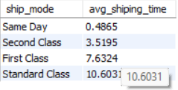

SELECT o.ship_mode,
AVG(DATEDIFF(o.ship_date_clean,o.order_date_clean))AS avg_shiping_time
FROM orders o
GROUP BY o.ship_mode
ORDER BY avg_shiping_time ;
QUERY 6: AVG SHIPPING
TIME PER SHIP MODE
Objective: Calculate Average Shipping Days by Ship Mode
Using DATEDIFF() and GROUP BY, we calculate the average number of days from order to shipment for each ship mode. Results reveal that Same Day is fastest (~0 days), while Standard Class averages ~5 days. This insight guides logistics optimization and customer expectation management.

Slide 11
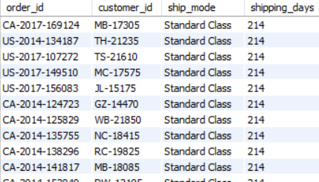
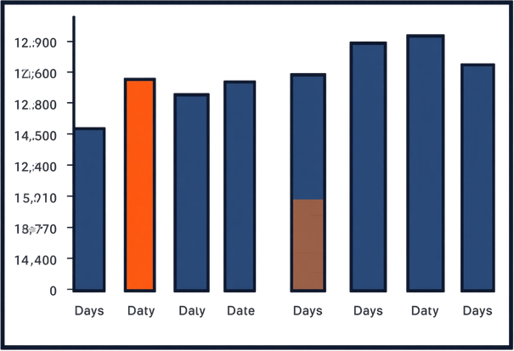

SELECT o.order_id,o.customer_id,o.ship_mode,
DATEDIFF(o.ship_date_clean, o.order_date_clean) AS shipping_days
FROM orders o
ORDER BY shipping_days DESC;
QUERY 7: SHIPPING
TIME PER ORDER
Objective: List Shipping Time for Every Single Order
SQL Technique: DATEDIFF(ship_date, order_date) combined with ORDER BY to rank orders by delivery duration. Insight: Orders with exceptionally long shipping times are flagged for review, enabling proactive customer service intervention and logistics improvement.

Slide 12
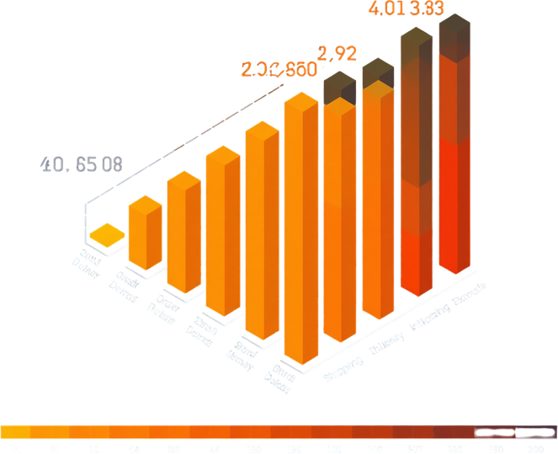
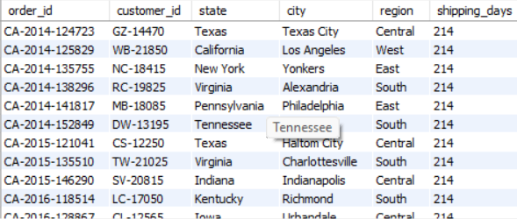

SELECT o.order_id,o.customer_id,o.state,o.city,o.region,
DATEDIFF(o.ship_date_clean, o.order_date_clean) AS shipping_days
FROM orders o
WHERE DATEDIFF(o.ship_date_clean, o.order_date_clean) > 10
ORDER BY shipping_days DESC;t
QUERY 8: ORDERS
SHIPPING TIME > 10 DAYS
Objective: Pinpoint Delayed Deliveries Impacting Satisfaction
Find all orders where shipping time exceeded 10 days. Uses DATEDIFF() to calculate delivery duration and filters with WHERE clause. Insight: These delayed orders flag critical fulfillment gaps — high shipping times directly correlate with lower customer satisfaction and potential churn risk.

Slide 13
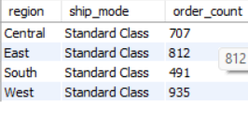
SELECT region, ship_mode, order_count
FROM (
SELECT o.region,o.ship_mode,
COUNT(*) AS order_count,
RANK() OVER (PARTITION BY o.region ORDER BY COUNT(*) DESC) AS rnk
FROM orders o
GROUP BY o.region, o.ship_mode
) ranked
WHERE rnk = 1
ORDER BY region;
QUERY 9: MOST COMMON
SHIP MODE PER REGION
Regional Shipping Preferences Identified
Objective: Identify the preferred shipping mode in each region using COUNT() and RANK() window function partitioned by region.
Technique: RANK() OVER (PARTITION BY region ORDER BY COUNT(*) DESC) to surface the top ship mode per region.
Insight: Regional shipping preferences vary — Standard Class dominates most regions, while some regions show higher reliance on Second Class or First Class. These patterns inform localized logistics planning and cost optimization strategies.

Slide 14
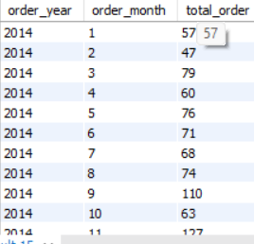
SELECT YEAR(o.order_date_clean) AS order_year,
MONTH(o.order_date_clean) AS order_month,
COUNT(o.order_id) AS total_order
FROM orders o
WHERE o.order_date_clean BETWEEN '2014-01-01' AND '2017-12-31'
GROUP BY YEAR(o.order_date_clean),MONTH(o.order_date_clean)
ORDER BY order_year,order_month;
QUERY 10
MONTHLY ORDER COUNTS
Tracking Order Volume: 2014–2017
SQL: YEAR(), MONTH(), GROUP BY order date to aggregate monthly volumes. Seasonal peaks in Q4 (Nov–Dec) and mid-year surges reveal demand cycles. Year-over-year growth visible across all months, supporting accurate demand forecasting and inventory planning.

Slide 15
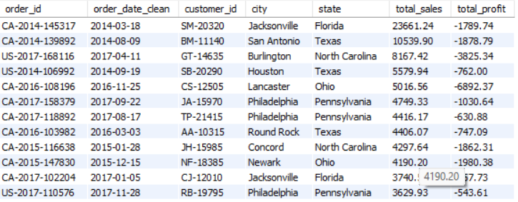
SELECT o.order_id,o.order_date_clean,o.customer_id,o.city,o.state,
SUM(s.sales) AS total_sales,
SUM(s.profit) AS total_profit
FROM orders o
INNER JOIN sales s ON o.order_id = s.order_id
GROUP BY o.order_id,o.order_date_clean,o.customer_id,o.city,o.state
HAVING SUM(s.sales) > 1000 AND SUM(s.profit) <0
ORDER BY total_sales DESC;
HIGH SALES,
NEGATIVE PROFIT ORDERS
Query 11 — Costly Orders Requiring Pricing Review
Objective: Identify orders with sales > $1,000 but negative profit. Technique: WHERE sales > 1000 AND profit < 0. Insight: High-revenue orders with negative margins reveal excessive discounting, high shipping costs, or pricing errors — flagged for immediate cost and pricing strategy review.

Slide 16


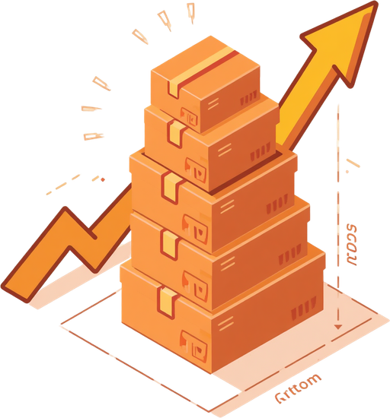
PRODUCT
PERFORMANCE
Queries 12 – 17
Analyzing profitability, discounts, and product popularity across categories, subcategories, and regions.

Slide 17
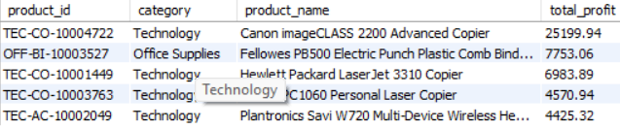
SELECT p.product_id,p.category,p.product_name,
SUM(s.profit) AS total_profit
FROM products p
INNER JOIN sales s ON p.product_id = s.product_id
GROUP BY p.product_id,p.category,p.product_name
ORDER BY total_profit DESC
LIMIT 5;
QUERY 12:
TOP 5 PRODUCTS BY PROFIT
Objective: Identify the Most Profitable Products
SQL Technique: GROUP BY product name, SUM(profit) aggregation, ORDER BY DESC with LIMIT 5.
Insight: Star products driving the highest profits are revealed — these high-margin items deserve priority in inventory planning, marketing spend, and supply chain focus to maximize overall business profitability.

Slide 18
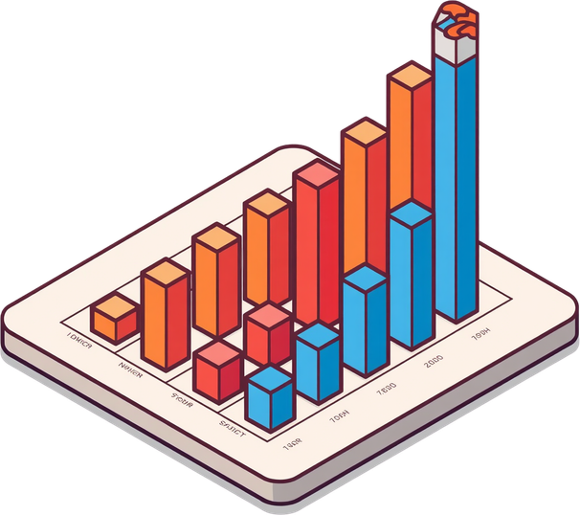
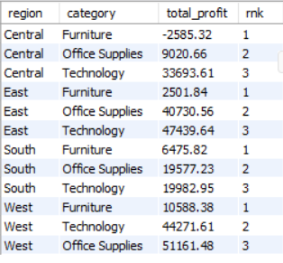

SELECT o.region,p.category,
SUM(s.profit) AS total_profit,
RANK() OVER (PARTITION BY o.region ORDER BY SUM(s.profit)) AS rnk
FROM products p
LEFT JOIN sales s ON p.product_id = s.product_id
LEFT JOIN orders o ON s.order_id = o.order_id
GROUP BY o.region, p.category
ORDER BY o.region, rnk;
LEAST PROFITABLE
CATEGORY PER REGION
Query 13: Regional Category Profitability Analysis
Objective: Identify product categories with the lowest profit in each geographic region.
SQL Technique: Window function RANK() OVER (PARTITION BY region ORDER BY SUM(profit) ASC) to rank categories ascending by profit.
Insight: Reveals underperforming categories per region — guiding decisions on discontinuation, repricing, or targeted improvement strategies.

Slide 19
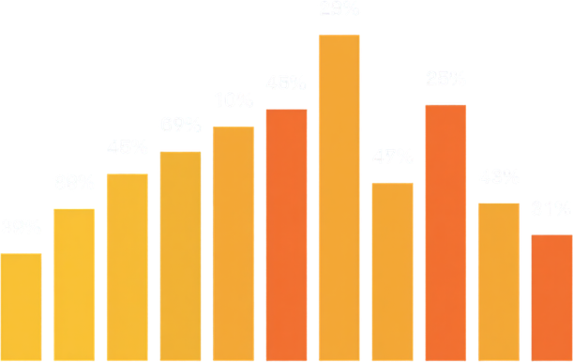
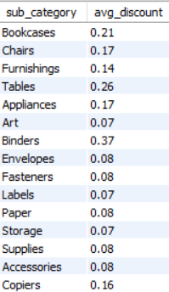

SELECT p.sub_category,
ROUND(AVG(s.discount),2) AS avg_discount
FROM products p
INNER JOIN sales s ON p.product_id = s.product_id
GROUP BY p.sub_category;
QUERY 14: AVERAGE
DISCOUNT BY SUBCATEGORY
Objective & SQL Technique
Calculate the average discount applied to each product subcategory. Uses GROUP BY with AVG(discount) to reveal how discounting strategies differ across subcategories — and how these variations directly impact profit margins and overall sales performance.

Slide 20

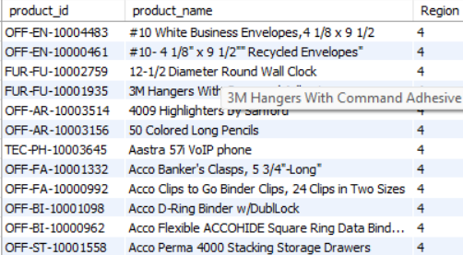

SELECT p.product_id,p.product_name,
COUNT(DISTINCT o.region) AS Region
FROM products p
INNER JOIN sales s ON p.product_id = s.product_id
INNER JOIN orders o ON o.order_id = s.order_id
GROUP BY p.product_id,p.product_name
HAVING COUNT(DISTINCT o.region) = 4
ORDER BY p.product_name;
QUERY 15: PRODUCTS
SOLD IN ALL REGIONS
Core Products with Broad Market Appeal
Objective: Identify products sold in every geographic region. SQL Technique: GROUP BY product, HAVING COUNT(DISTINCT region) = 4. Insight: These core products demonstrate universal market appeal and should be prioritized for inventory, promotions, and supply chain reliability across all regions.

Slide 21
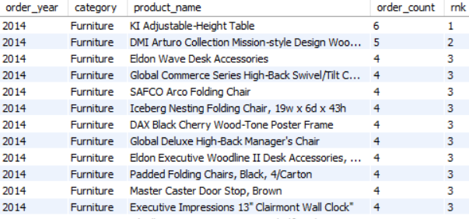
SELECT YEAR(o.order_date_clean) AS order_year,
p.category,p.product_name,
COUNT(s.order_id) AS order_count,
DENSE_RANK() OVER (PARTITION BY YEAR(o.order_date_clean),p.category ORDER BY COUNT(s.order_id) DESC) AS rnk
FROM products p
INNER JOIN sales s ON p.product_id = s.product_id
INNER JOIN orders o ON s.order_id = o.order_id
GROUP BY YEAR(o.order_date_clean),p.category, p.product_name ;
QUERY 16: MOST
FREQUENTLY ORDERED
PRODUCT PER CATEGORY
SQL Technique: DENSE_RANK() Window Function
Objective: Rank products by order frequency within each category to identify the most popular items. Using DENSE_RANK() OVER (PARTITION BY category ORDER BY COUNT(order_id) DESC), products are ranked without gaps. Insight: Staples lead Office Supplies, Binders rank high in volume — these popular products guide inventory prioritization and restocking strategies.

Slide 22
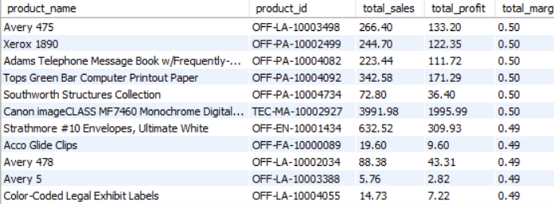
SELECT p.product_name,p.product_id,
SUM(s.sales ) AS total_sales,
SUM(s.profit) AS total_profit,
ROUND(SUM(profit)/SUM(sales),2) AS total_margin
FROM products p
INNER JOIN sales s ON p.product_id = s.product_id
GROUP BY p.product_name,p.product_id
ORDER BY total_margin DESC;
QUERY 17: PROFIT
MARGIN PER PRODUCT
Profit Margin Calculation (Profit ÷ Sales)
Objective: Calculate profit margin ratio for each product to distinguish high-margin from low-margin items.
SQL Technique: SELECT product_name, SUM(profit)/SUM(sales) AS profit_margin FROM orders GROUP BY product_name ORDER BY profit_margin DESC.
Insight: High-margin products drive profitability even with lower sales volume, while low or negative margin products erode overall profit — guiding pricing and discount strategies.

Slide 23
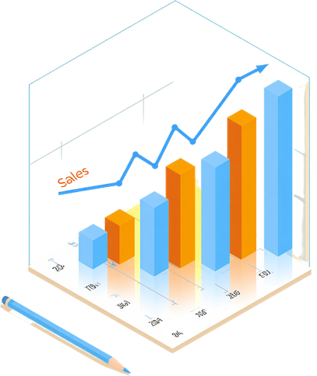


ORDER & SALES
DEEP DIVE
Section 4 of 6
Examining orders and sales value for business insights — covering top orders by value, discount profitability analysis, and largest orders per customer.

Slide 24
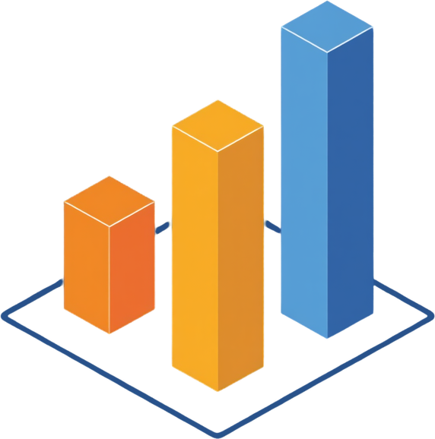


SELECT o.order_id,
SUM(s.sales) AS total_sales
FROM orders o
INNER JOIN sales s ON o.order_id = s.order_id
GROUP BY o.order_id
ORDER BY total_sales DESC
LIMIT 3;
QUERY 18: TOP 3
ORDERS BY SALES VALUE
Objective: Identify the Highest Value Orders
SQL Technique: ORDER BY sales DESC with LIMIT 3. These top-value orders represent premium transactions ideal for case studies and white-glove service. Insight: Focusing on large orders enables targeted premium support, upsell opportunities, and deeper account management for high-revenue customers.

Slide 25
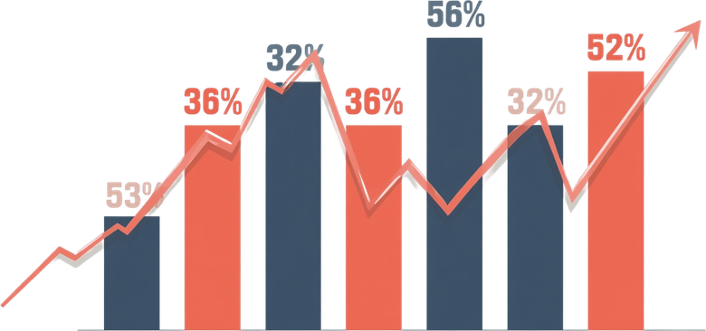
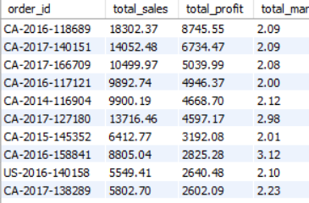

SELECT o.order_id ,
SUM(s.sales) AS total_sales,
SUM(s.profit) AS total_profit,
ROUND(SUM(s.sales)/SUM(s.profit),2) AS total_margin
FROM orders o
INNER JOIN sales s ON o.order_id = s.order_id
GROUP BY o.order_id
ORDER BY total_profit DESC;
QUERY 19: HIGH DISCOUNT
ORDERS PROFITABILITY CHECK
Objective & SQL Technique
Analyze profitability of orders where discount > 50%. Uses WHERE discount > 0.5 with SUM(profit), SUM(sales), GROUP BY order_id. Insight: Steep discounts severely erode margins — most high-discount orders yield negative profit, signaling a need to cap discount thresholds and re-evaluate promotional pricing strategies.

Slide 26
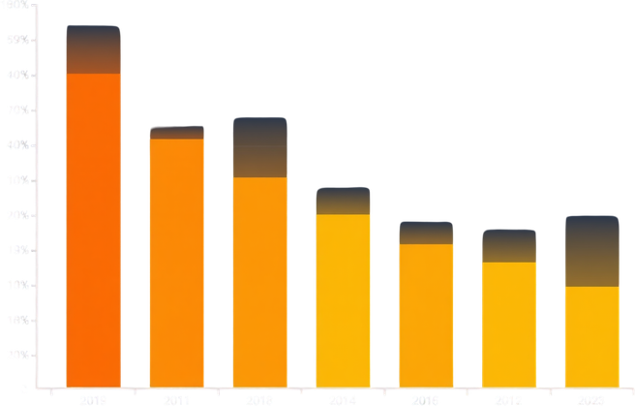
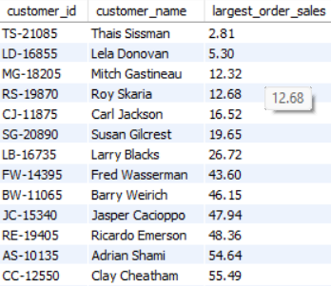
SELECT sub.customer_id,sub.customer_name,
MAX(sub.total_sales) AS largest_order_sales
FROM (
SELECT c.customer_id,c.customer_name,o.order_id,
SUM(s.sales) AS total_sales
FROM customers c
INNER JOIN orders o ON c.customer_id = o.customer_id
INNER JOIN sales s ON o.order_id = s.order_id
GROUP BY c.customer_id,c.customer_name,o.order_id
) sub
GROUP BY sub.customer_id,sub.customer_name
ORDER BY largest_order_sales;
QUERY 20: LARGEST
ORDER PER CUSTOMER
Customer Purchase Power & Upsell Targets
Objective: Determine each customer's single largest order by total sales value.
SQL Technique: MAX(sales) with GROUP BY customer, or ROW_NUMBER() / RANK() window function partitioned by customer ordered by sales DESC.
Insight: Reveals high-value purchase behavior per customer — identifying top spenders and potential upsell or premium service targets.
Business Value: Customers with large single orders signal high purchase power and are prime candidates for loyalty programs and personalized outreach.

Slide 27


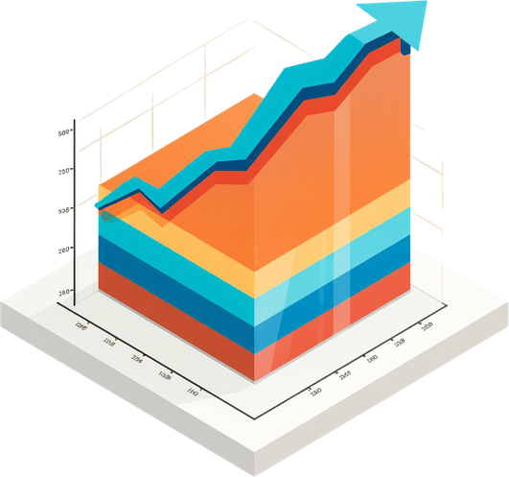
ADVANCED ANALYTICS
WITH WINDOW FUNCTIONS
Section 5: Window Functions Deep Dive
Leveraging SQL window functions for deeper insights — covering Queries 21–25 with RANK(), DENSE_RANK(), LAG(), and partitioned analytics for advanced business intelligence.

Slide 28
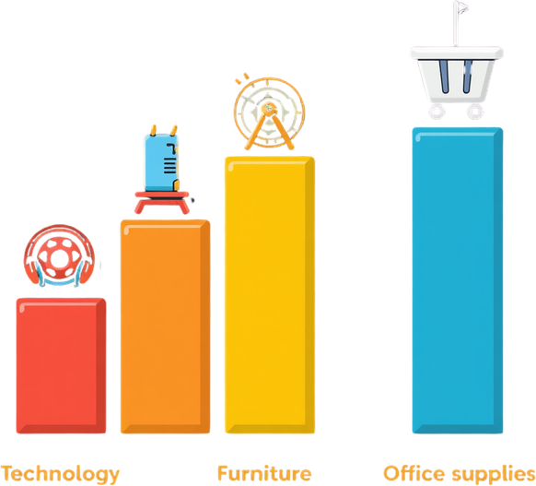
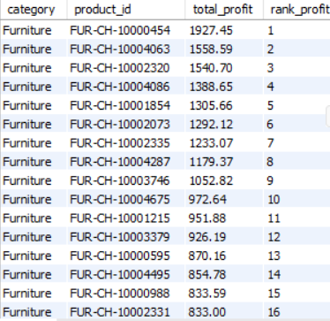

SELECT p.category,p.product_id,
SUM(s.profit) AS total_profit,
RANK() OVER (PARTITION BY p.category ORDER BY SUM(s.profit) DESC) AS rank_profit
FROM products p
INNER JOIN sales s ON p.product_id = s.product_id
GROUP BY p.category,p.product_id
ORDER BY p.category,rank_profit;
QUERY 21 -
PRODUCT RANKING BY PROFIT
Ranking Products by Profit Within Each Category
Uses RANK() window function partitioned by category to rank each product by total profit. Reveals top and bottom performers within Technology, Furniture, and Office Supplies. Insight: Identifies which products lead or lag within their category, enabling targeted inventory, pricing, and promotional decisions based on category-relative performance.

Slide 29



SELECT category,product_id,product_name,total_profit
FROM (
SELECT p.category,p.product_name,p.product_id,
SUM(s.profit) AS total_profit,
RANK() OVER (PARTITION BY p.category ORDER BY SUM(s.profit) DESC) AS rnk
FROM products p
INNER JOIN sales s ON p.product_id = s.product_id
GROUP BY p.category,p.product_id,p.product_name
) sub
WHERE rnk = 1
ORDER BY category;
QUERY 22:
TOP PRODUCT PER CATEGORY
Flagging Category Leaders Using RANK()
Objective: Identify the highest-profit product in each category using the RANK() window function partitioned by category. SQL Technique: RANK() OVER (PARTITION BY category ORDER BY SUM(profit) DESC). Insight: Category leaders like Copiers (Technology), Chairs (Furniture), and Binders (Office Supplies) dominate profits — flagging these products for priority stocking, marketing focus, and strategic investment decisions.

Slide 30
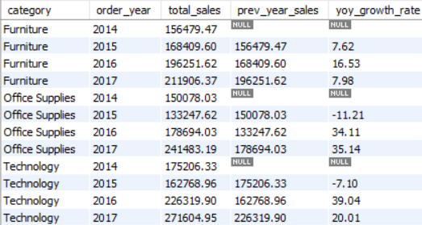
SELECT p.category,
YEAR(o.order_date_clean) AS order_year,
SUM(s.sales) AS total_sales,
LAG(SUM(s.sales)) OVER (PARTITION BY p.category ORDER BY YEAR(o.order_date_clean)) AS prev_year_sales
,ROUND((SUM(s.sales) - LAG(SUM(s.sales)) OVER (PARTITION BY p.category ORDER BY YEAR(o.order_date_clean)) )
/ LAG(SUM(s.sales)) OVER (PARTITION BY p.category ORDER BY YEAR(o.order_date_clean)) * 100, 2) AS yoy_growth_rate
FROM products p
JOIN sales s ON p.product_id = s.product_id
JOIN orders o ON s.order_id = o.order_id
GROUP BY p.category, YEAR(o.order_date_clean)
ORDER BY p.category, order_year;
QUERY 23: YEAR-OVER-YEAR
GROWTH RATE BY CATEGORY
LAG() Window Function — Sales Trend Analysis
Objective: Calculate YoY sales growth for each product category using LAG() to compare current vs. prior year sales. SQL Technique: LAG() window function partitioned by category, ordered by year, with growth % = (current - prior) / prior * 100. Insight: Identifies categories with accelerating or declining sales trends, enabling data-driven forecasting and strategic investment decisions.

Slide 31
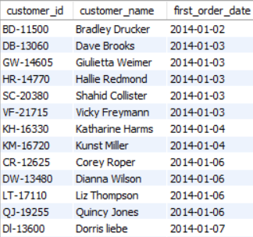
SELECT c.customer_id,c.customer_name,
MIN(o.order_date_clean) AS first_order_date
FROM customers c
JOIN orders o ON c.customer_id = o.customer_id
GROUP BY c.customer_id, c.customer_name
ORDER BY first_order_date;
QUERY 24: FIRST ORDER
DATE PER CUSTOMER
Customer Lifecycle & Cohort Analysis Foundation
Objective: Find the earliest order date placed by each customer using MIN(order_date) with GROUP BY customer_id. SQL Technique: Aggregation with MIN(), JOIN on orders and customers tables, ORDER BY first order date. Insight: Reveals customer acquisition timelines, enabling cohort analysis to track retention, lifetime value, and purchasing behavior evolution over time.

Slide 32
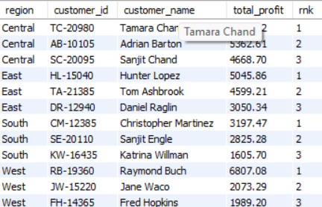
SELECT region,customer_id,customer_name,total_profit,rnk
FROM (
SELECT o.region,c.customer_id,c.customer_name,
SUM(s.profit) AS total_profit,
RANK() OVER (PARTITION BY o.region ORDER BY SUM(s.profit) DESC) AS rnk
FROM customers c
INNER JOIN orders o ON c.customer_id = o.customer_id
INNER JOIN sales s ON o.order_id = s.order_id
GROUP BY o.region, c.customer_id, c.customer_name
) ranked
WHERE rnk <= 3
ORDER BY region, rnk;
QUERY 25: TOP 3
CUSTOMERS PER REGION
Objective: Rank Top 3 Customers by Profit Within Each Region
Using DENSE_RANK() partitioned by region and ordered by SUM(profit) DESC, this query identifies the top 3 profit-generating customers in each geographic region. These regional key accounts are critical targets for personalized engagement, loyalty programs, and premium service offerings to maximize retention and revenue.

Slide 33
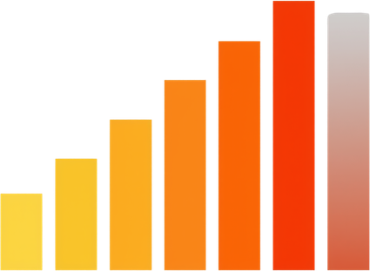

SUMMARY & KEY TAKEAWAYS
Core Insights from 25 SQL Queries
on the Superstore Sales Database
Customer segmentation reveals key profit drivers and risk areas
Shipping analysis highlights opportunities to improve delivery speed
Product performance insights guide inventory and pricing strategies
Sales deep dive identifies high-value orders and discount impact
Advanced analytics enable targeted, data-driven business decisions

Slide 34

RUSHIKESH
NARAYAN
SULTANE
BSc Data Science
Presenter Introduction
Project: Superstore Sales Database Analysis — 25 SQL Queries with Insights. Exploring customer behavior, shipping performance, product profitability, and advanced analytics using structured SQL techniques.

Slide 35


THANK YOU!
Superstore Sales Database Analysis
25 SQL Queries with Insights
Rushikesh Narayan Sultane
9834987900
rushikesh.sultane@email.com
www.linkedin.com/in/rushi-sultane-32284b381

